Slide 1
Project Description
The project works in the normal parameters for adding a person only as an employee and not as a team Leader

Slide 2
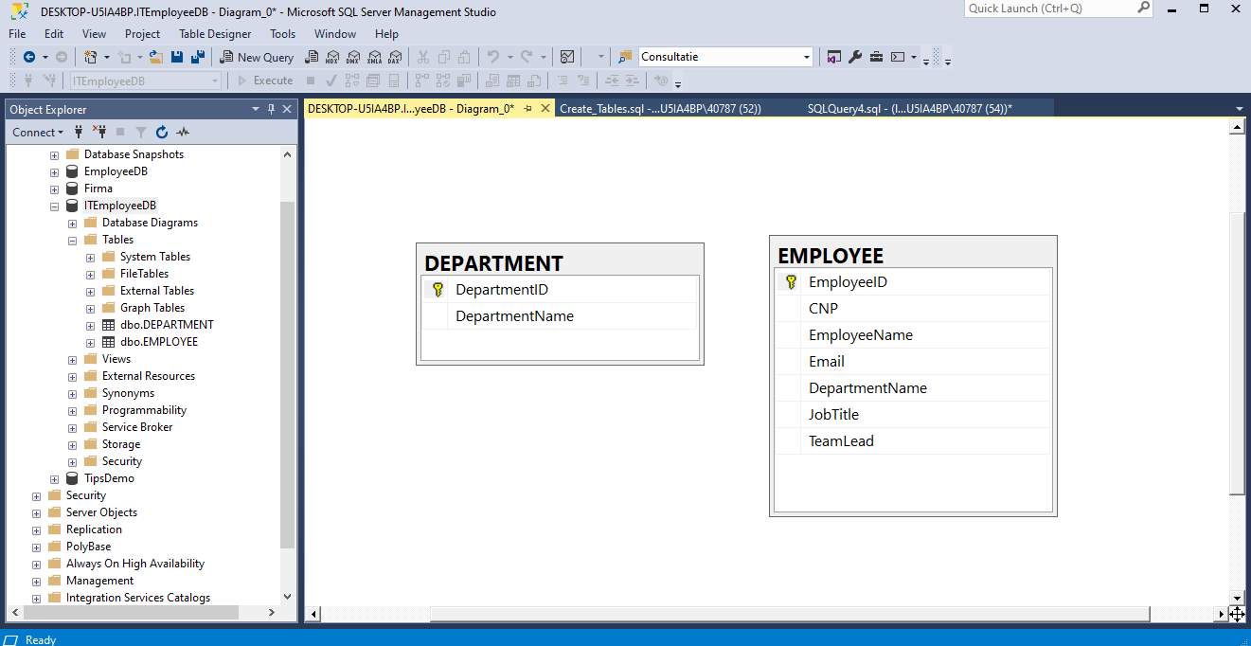
Database created with Microsoft SQL Server

Slide 3
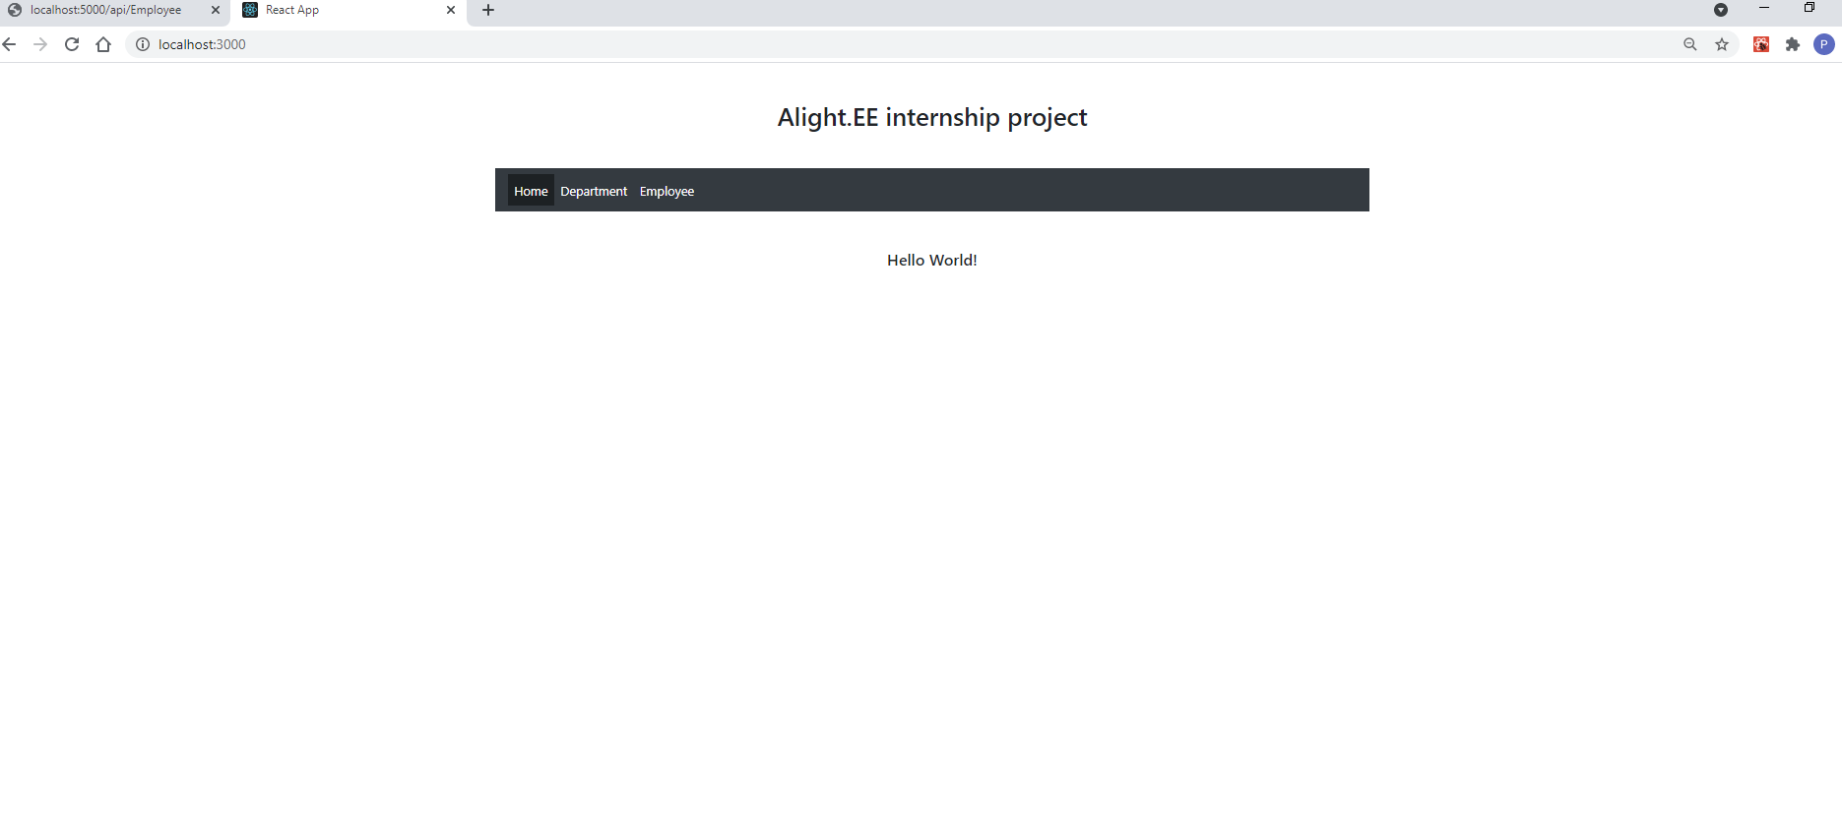
Home page
Employee page
Home page
Department page

Slide 4
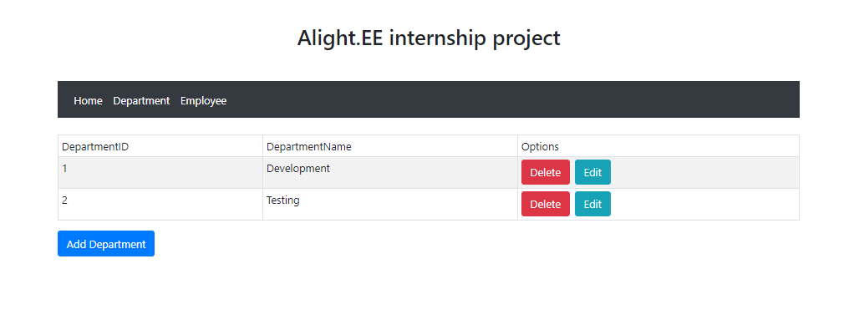
Department page

Slide 5
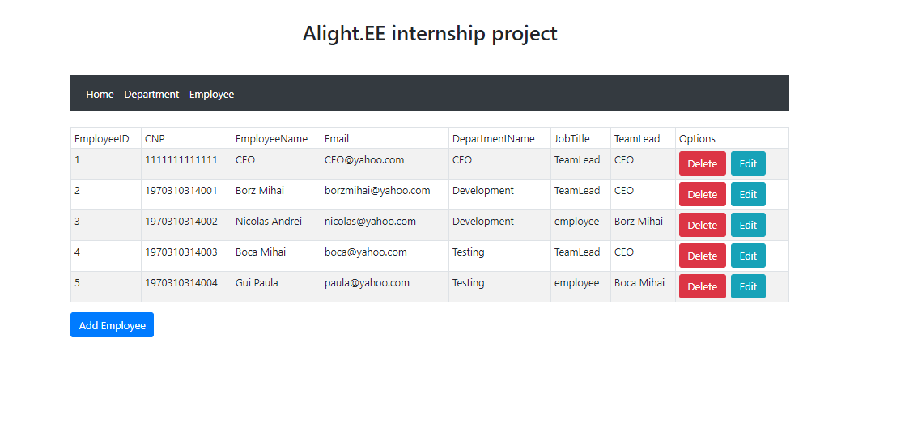
Employee page
When the new employee is chosen Team Leader, the Team Leader’s “JobTitle” status is changed in “TeamLead”

Slide 6
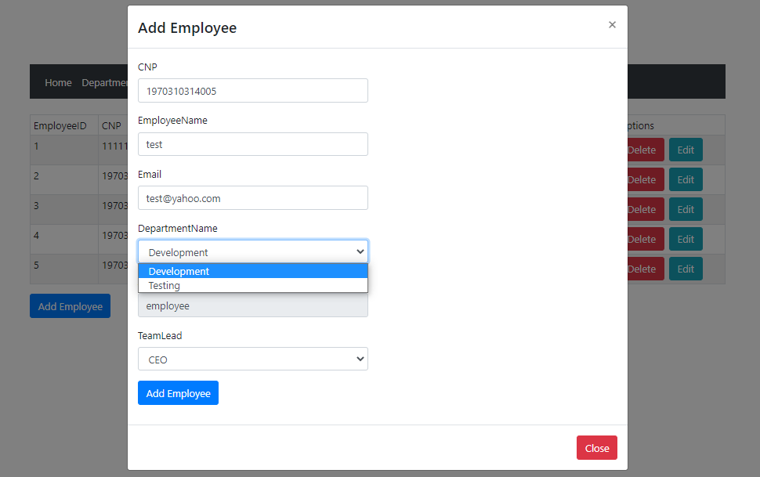
Add new Employee
Existing departments in the dbo.department table

Slide 7
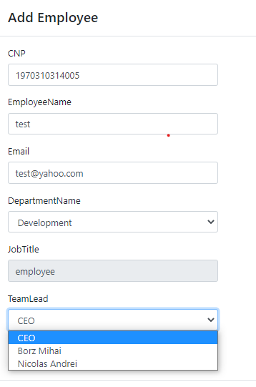
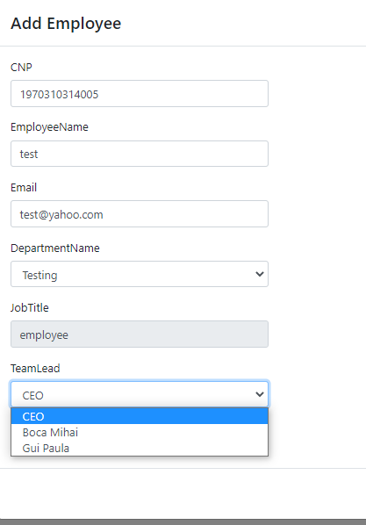
Team leaders by department
When I choose the development department
When I choose the testing department

Slide 8
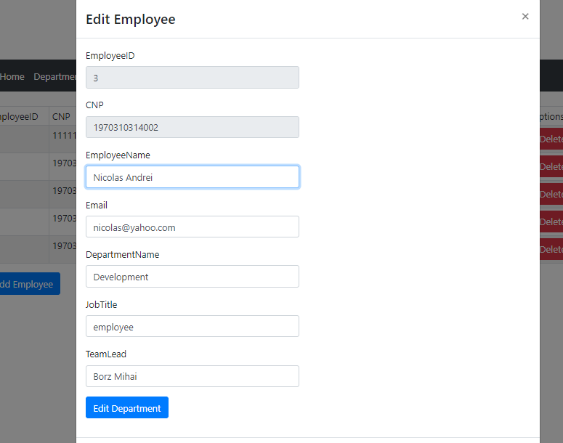
Edit Employee
CNP and EmployeeID cannot be changed

Slide 9
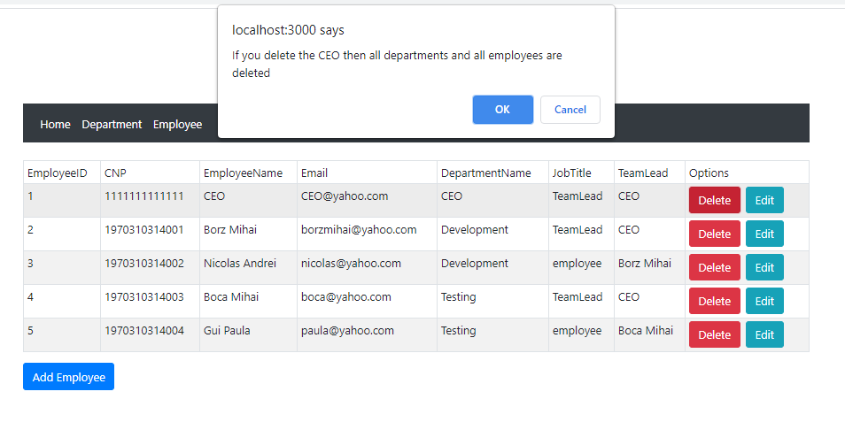
Alerts
If I delete the CEO and there are employees and departments

Slide 10
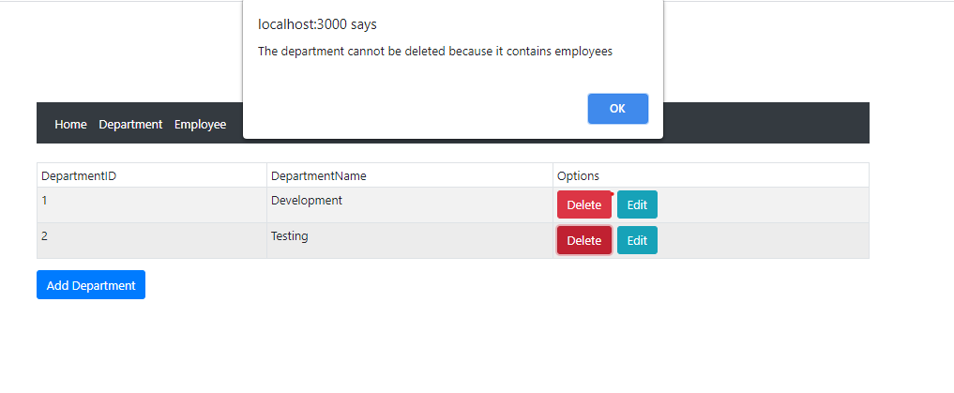
Alerts
If I delete an department and there are employees in that department

Slide 11
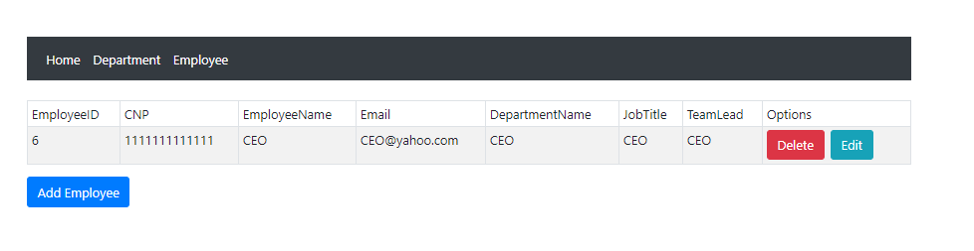
The employed CEO is automatically added when I add the first Department

Slide 12
Thanks!

